Slide 1
How Will the Change to
a Bi-weekly Pay Schedule Impact Me?

Slide 2
What is happening?
Wayne County is implementing a bi-weekly pay schedule for all employees
Changing pay from the 25th of the month to a bi-weekly pay every other Friday
Transition period will begin in March 2023
Full implementation will be April 1st 2023

Slide 3
Why move to bi-weekly pay?
Standardize pay practices across the County
More efficient and effective time reporting
Reduction in manual adjustments due to after-the-fact reporting
Reduction in overpayments
Vacation and sick leave balances will be current

Slide 4
What is the difference in pay cycles?
 | Monthly Pay Cycle | Bi-Weekly Pay Cycle
Pay Cycle | Sunday – Saturday 1st to last day of the month | Sunday to Saturday, two-week period
Paychecks per Year | 12 | 26
Paycheck Date | 25th of the month | Every other Friday after the completion of two work weeks.

Slide 5
How will this affect my pay?
The change in payroll schedule will not reduce what you earn
Bi-weekly pay will be calculated on actual time worked versus the existing advanced pay schedule
There will be a timing change in the pay schedule as we move from advanced pay to actual pay
This means a ONE-TIME pay adjustment to transition from advanced to actual pay
Full time employees - final full monthly paycheck will on February 24, 2023 covering Feb. 1-28

Slide 6
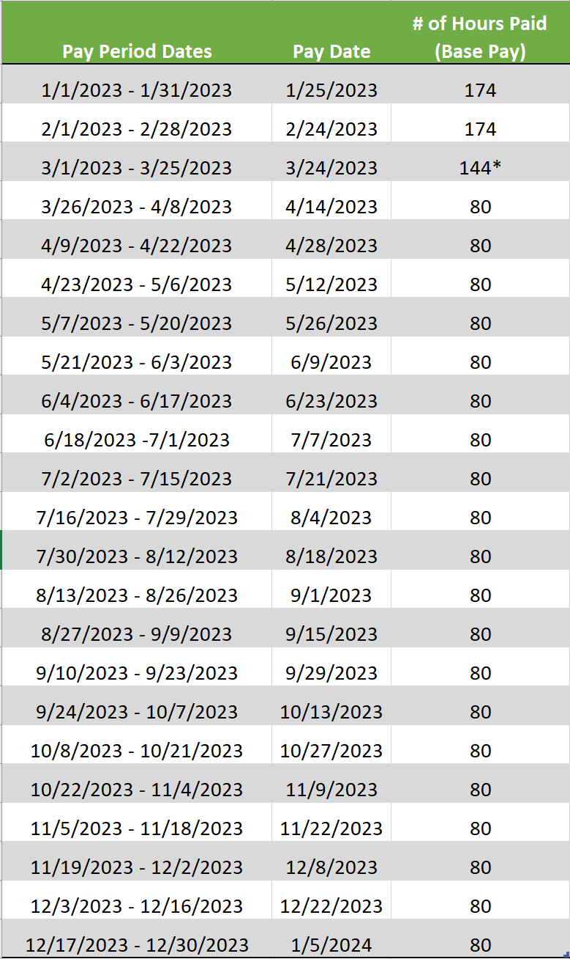
2023 Full Time Employee Conversion Pay Schedule
Full deduction amounts will come out
Catch up period for time taken and OT earned from 3/1-25 & 3/26-4/8

Slide 7
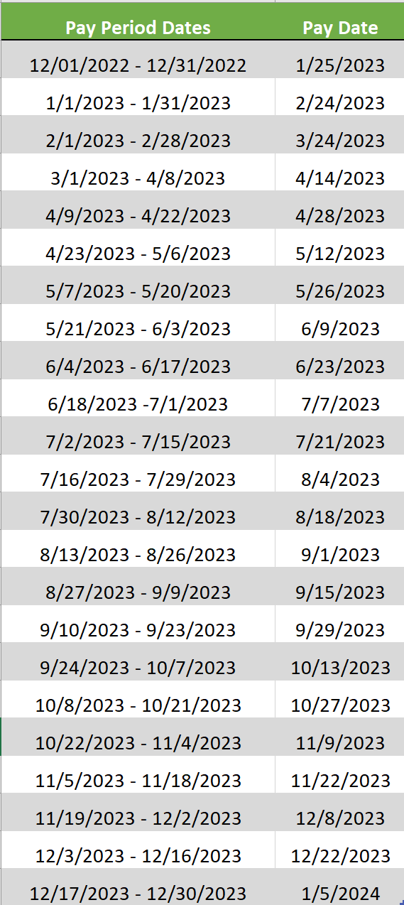
2023 Regular PT and Part Time Employee Conversion Pay Schedule
Catch up period

Slide 8
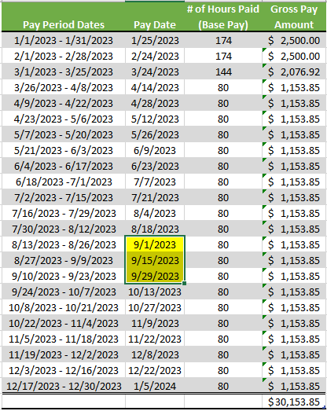
2023 Example
$30,000 Full Time Employee Pay After Transition

Slide 9
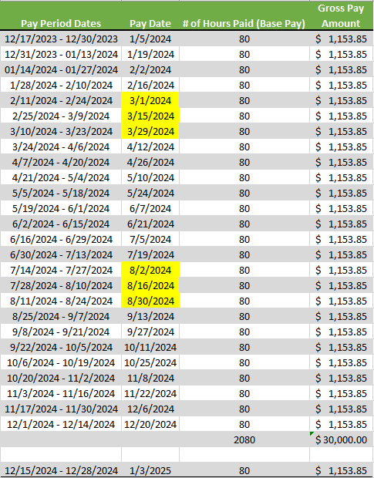
2024 Example
$30,000 Full Time Employee

Slide 10
How will benefits and deductions change for bi-weekly?
There are 26 bi-weekly paydays in most years
Typically 2 months out of the year there will be 3 bi-weekly paydays
The third payday in those months will be considered deduction holidays because certain deductions will only be taken out over 24 paydays (twice a month) instead of 26 paydays
Net pay will be more when there is a third paycheck in the month
Flat dollar deductions are taken out over 24 paychecks
Percentage based deductions are taken out over every paycheck (see list on next slide
Exception 401(k) & 457 flat amounts – Employee will need to make a change via the Prudential website after March 25th to avoid the full amount being withheld from each bi-weekly check.

Slide 11
How will benefits and deductions change for bi-weekly?
Deductions withheld every pay (26 paychecks) % based | Deductions withheld twice per month (24 paychecks)
Taxes (FICA, Medicare, Federal**, State**) | Health Insurance
Retirement | Supplemental Health Insurance (dental, vision, FSA, HSA, etc.)
401(k) & 457* | Involuntary deductions (Federal tax levy, child support, etc.)
Involuntary deductions (State & County Tax levy) | Voluntary deductions (Life, YMCA, United Way, AUL, Ad Valorem-Property Tax, etc.)
*401(k) & 457 – Those who contribute a flat amount will need to make a change via the Prudential website after March 25th to avoid the full amount coming out of each bi-weekly check.
**Federal/State Taxes – Employees who have an additional amount withheld will need to submit a new W-4/NC-4 after March 25th to avoid the full amount coming out of each check.

Slide 12
When will I be paid for …?
Opt Out – 1st pay period in June
Uniform Allowance – 1st pay period in July
Longevity – 1st pay period in November
Stipends - will be split in half and paid in 24 pay periods
(Travel Allowance, Cell Phone, Sheriff/Detention stipends, Recruitment/Retention Incentive)
Separation Allowance – If you receive, you will receive a letter with your specific payment schedule in early January. January, February, & March will be the same amount you receive now.

Slide 13
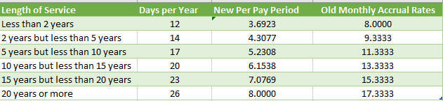
How will the change affect leave?
You will continue to earn the same amount of leave
The earned amount of leave will be granted at the end of each pay period instead of on a monthly basis
New Sick Leave Accrual – Full Time
New Vacation Leave Accrual – Full Time
Regular part time employees earn 75% of the FT rates.
Last full accrual – 3/24/23 paycheck
1st bi-weekly accrual – 4/14/23 paycheck

Slide 14
What can I do to prepare?
Change in pay date frequency means change in cash flow – plan ahead for the cash flow impact from the transition
Consider saving tax return to cover transitional period
Start reviewing your monthly expenses and the timing of your payments
Determine changes needed to payment due dates
Review your current federal/state tax withholding exemptions to make any necessary changes with the new bi-weekly pay frequency opposed to monthly
Pay particular attention to “additional” tax withholding amounts, as the amount designated will be withheld every bi-weekly paycheck (i.e. If you are currently withholding an additional $100, which is coming out monthly, then $100 will be withheld on each bi-weekly check) The bi-weekly equivalent amount would be figured as follows:
$100/month x 12 = $1,200/year
$1,200/26 pay periods = $46.15 per pay check

Slide 15
How do I find out about updates?
The website specifically for payroll conversion will be continuously updated with new information (https://www.waynegov.com/Payroll)
Visit the FAQ page on the County site under Finance/Payroll department for updates
For additional questions, please submit through the above website
Additional informational sessions will be scheduled in January for timekeepers and departments with special pay processes (911/EMS/Sheriff/Detention)
Review IRS.gov website to see tax tables

