Slide 1
Uniform guidance requirements for NC local governments
June 27, 2018
Presented by: Angie Boswell
Noelle Woods
Andrew neal

Slide 2

What is Uniform Guidance?
Rules that set uniform standards for the award and expenditure of federal financial assistance(grants and loans)
UG codified at 2 C.F.R. Part 200
Procurement standards codified at 2 C.F.R. Subpart D

Slide 3

Who Does the UG Apply To?
Non-Federal entities that receive federal financial assistance-states, nonprofits, Indian tribes, universities and colleges, and local governments

Slide 4
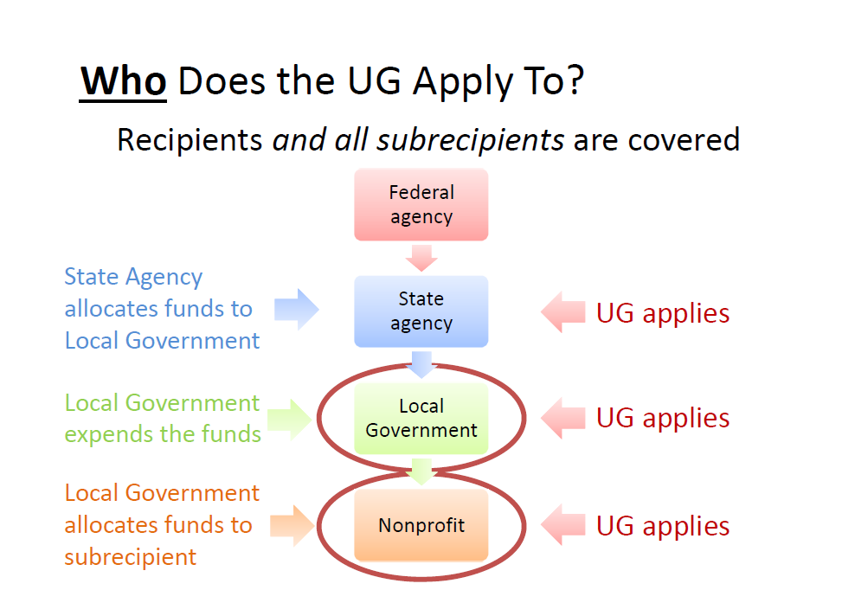

Slide 5
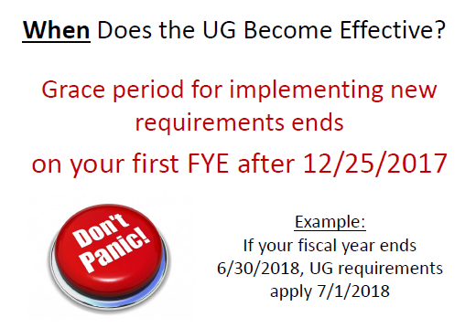

Slide 6
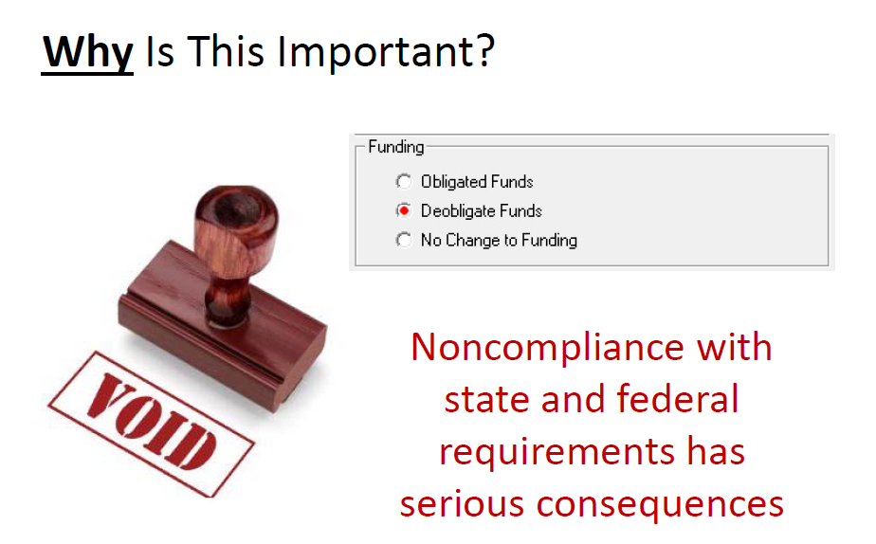

Slide 7

GRANTS
A copy of ALL grant applications are to be sent to Phil Parry.
2. A copy of ALL grant awards are to be sent to Phil Parry.

Slide 8
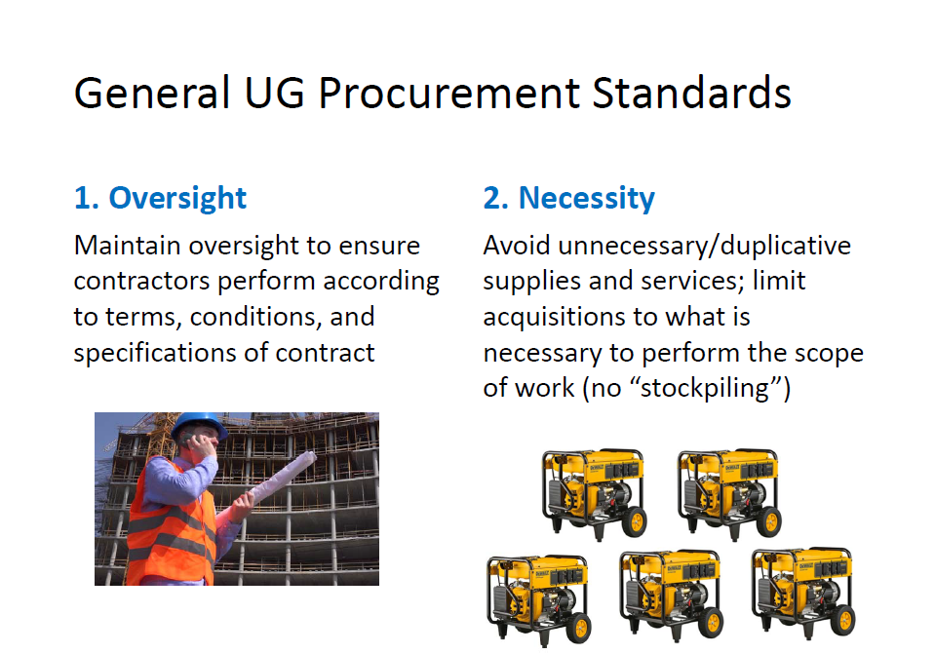
Top 10 Requirements for Uniform Guidance

Slide 9
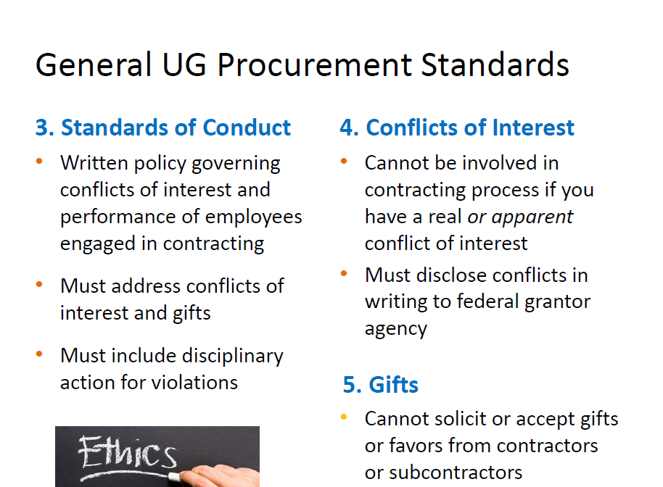

Slide 10
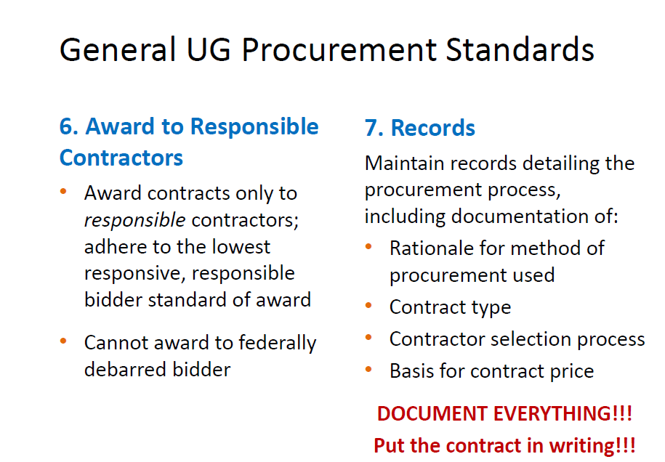
Please be reminded to check your lists!!
“Because the law requires it!”
“Fixed Price” or “Lowest Cost”

Slide 11
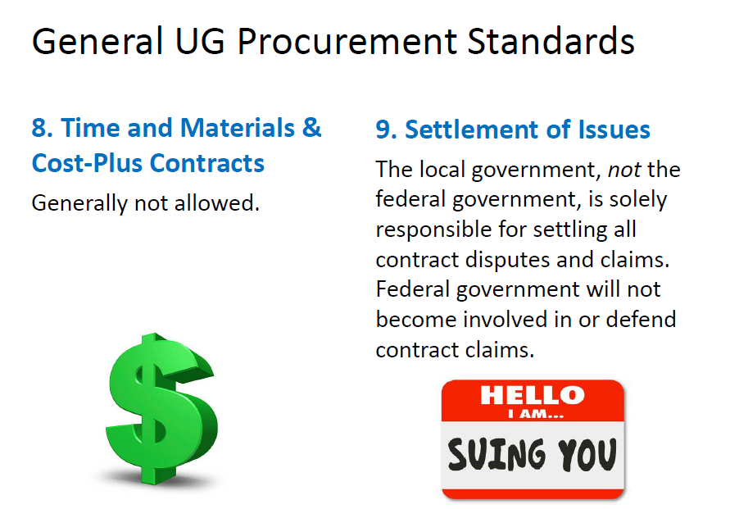

Slide 12
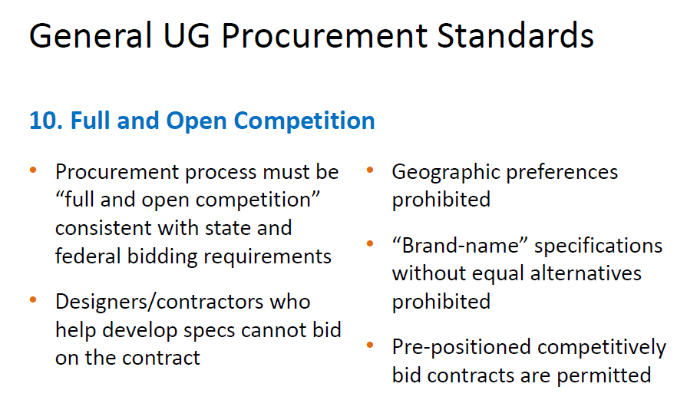

Slide 13
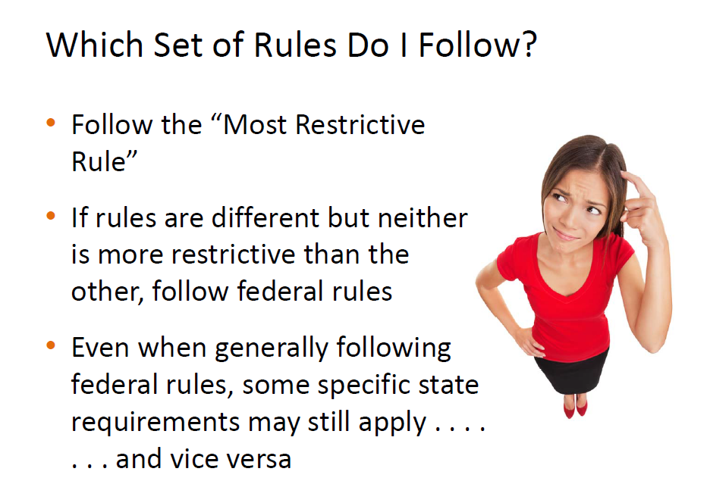

Slide 14
There are 2 types of CONTRACTS:
Purchase and Service
A. Purchasing contracts is anything tangible that you can purchase.
B. Service contracts are anything that you will be receiving a service for. (Something that you can’t physically touch)
Construction and Repair Contracts
A. A construction contract is for construction of any kind.
B. A repair contract deals with repairs for the upkeep
and maintenance of structures.

Slide 15
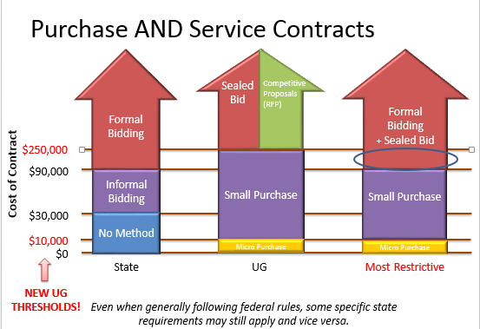
WC Policy has more restrictions on purchase thresholds between $0 - $10,000
**For purchases over $90,000 contact purchasing for assistance**

Slide 16
MICRO PURCHASE
Wayne County’s policy is more restrictive than the Federal Guidelines.
Level 1-A purchase from $1,000 - $2,499
Level 2-A purchase from $2,500 - $10,000
These guidelines have not changed because of Federal regulations. Please be reminded that when purchasing with Federal Grant Funds you will always use the policy that is most restrictive.

Slide 17
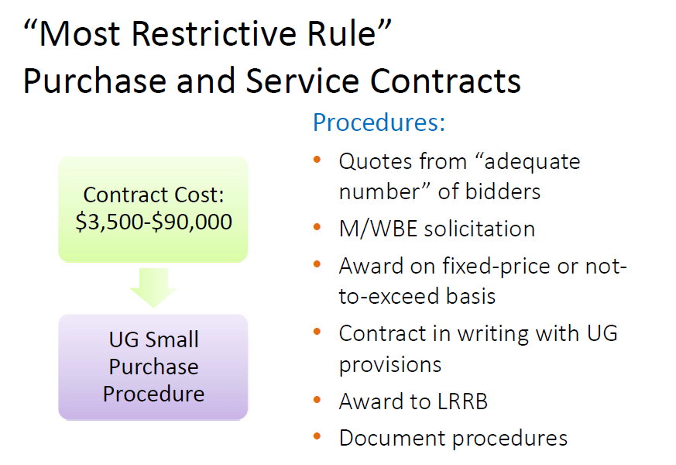
Small
Purchase
Contract Cost:
$10,000-$90,000
3
is WC’s Magic #

Slide 18
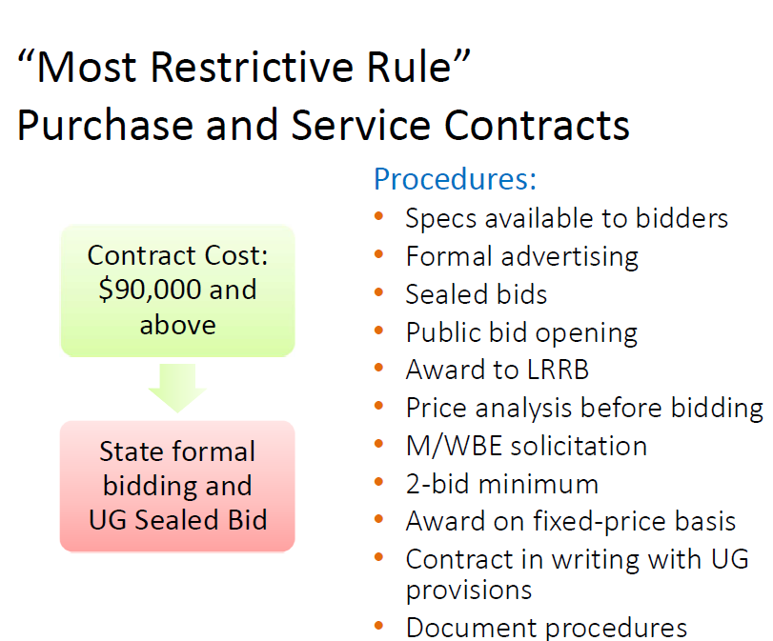
Formal Bidding & Sealed Bid
Projects in this range require Purchasing assistance

Slide 19
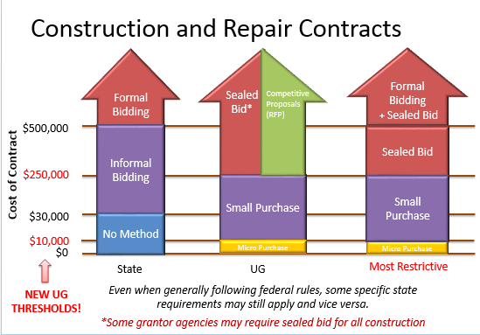
Any construction and repair contracts over $90,000 please contact Purchasing for assistance

Slide 20
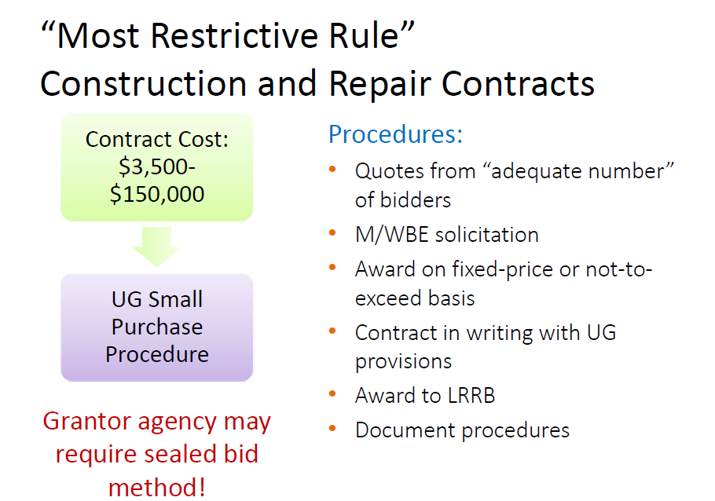
Small
Purchase
Contract Cost: $10,000-$250,000
3
is WC’s Magic #

Slide 21
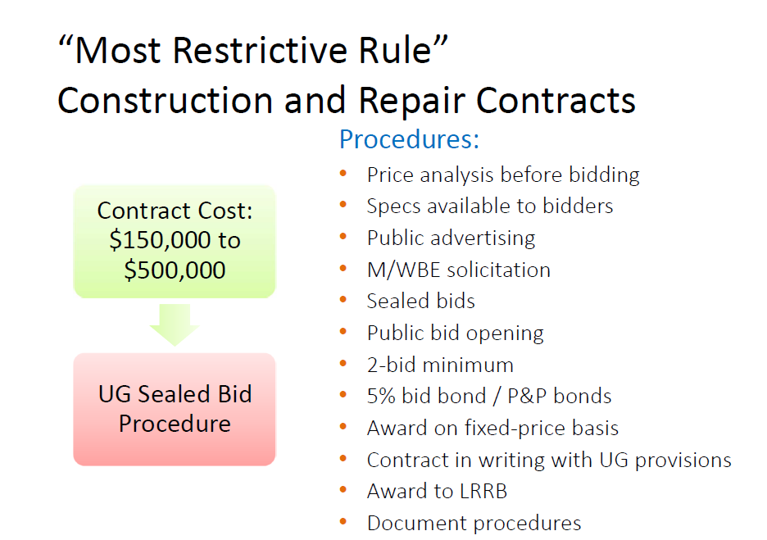
Sealed Bid
Contract Cost: $250,000-$500,000
3
is WC’s Magic #

Slide 22
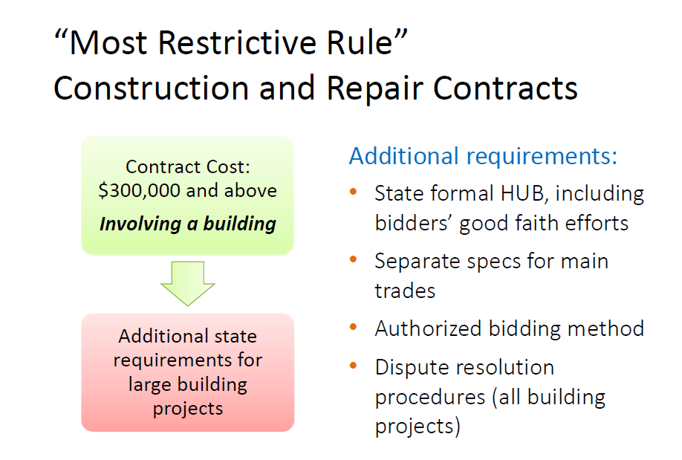
Formal Bidding & Sealed Bids

Slide 23
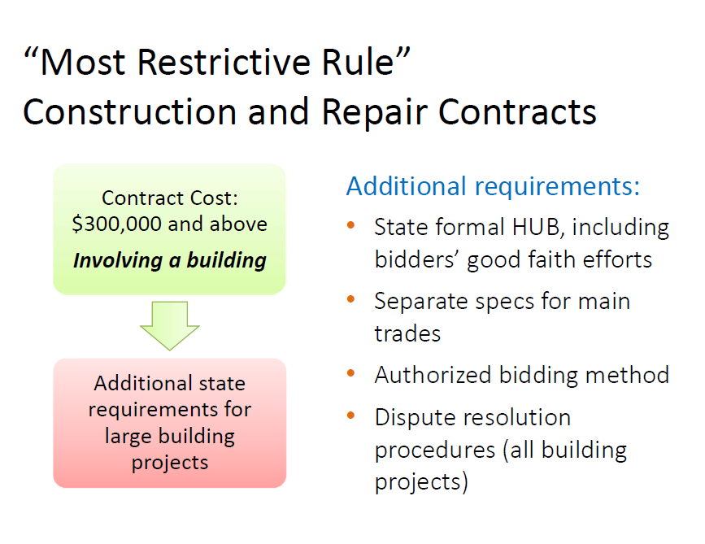
Formal Bidding & Sealed Bid
Contract Cost: $500,000 and Above
(Involving buildings)

Slide 24
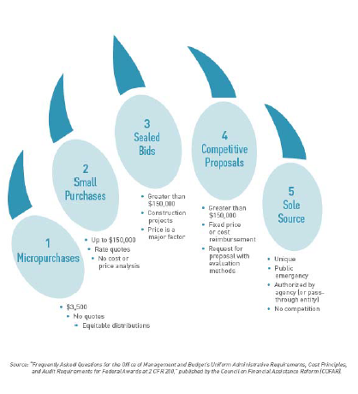

REMEMBER:
BEAR CLAW
Greater than $250,000
-Construction projects
-Price is a major factor
-Greater than $250,000
-Fixed price or cost reimbursement
-Request for proposal with evaluation Methods
U-Up to $250,000
-Rate Quotes
-No cost or price analysis
-Unique
-Public Emergency
-Authorized by agency or pass through Entity
-No Competition
-$10,000
-No Quotes
-Equitable distributors

Slide 25
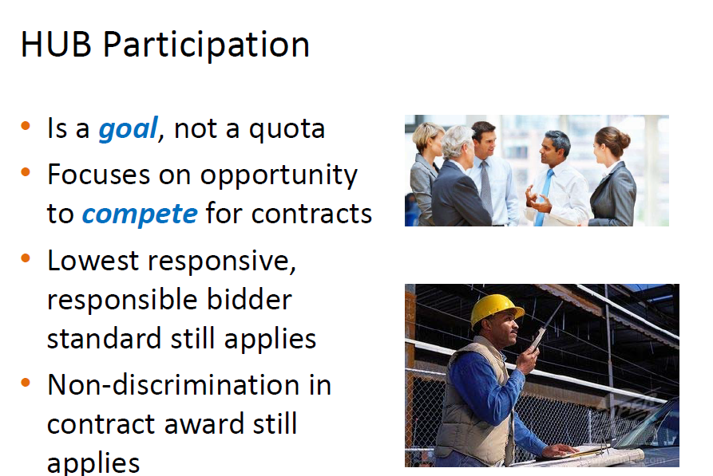


Slide 26
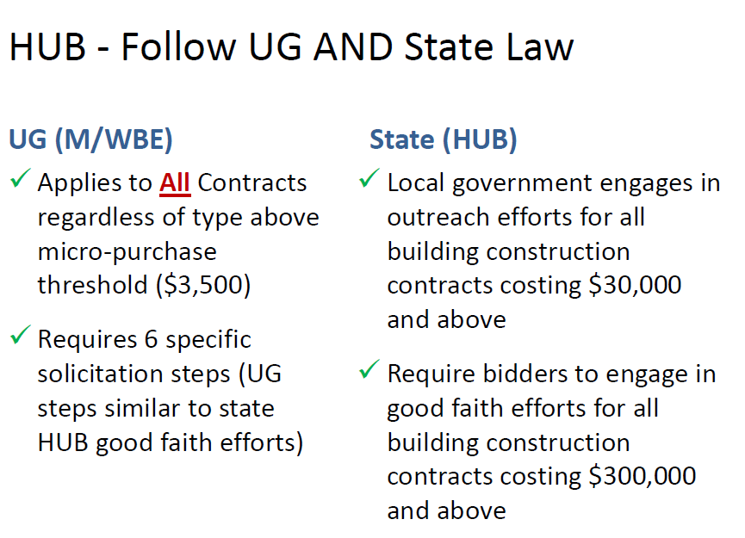
$10,000

Slide 27
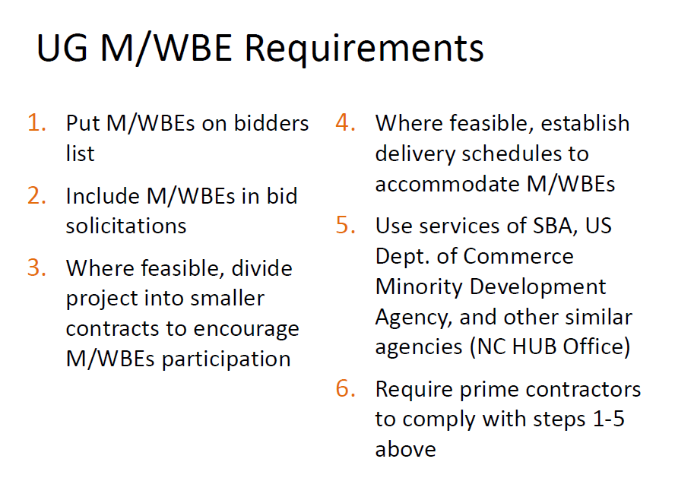

Slide 28
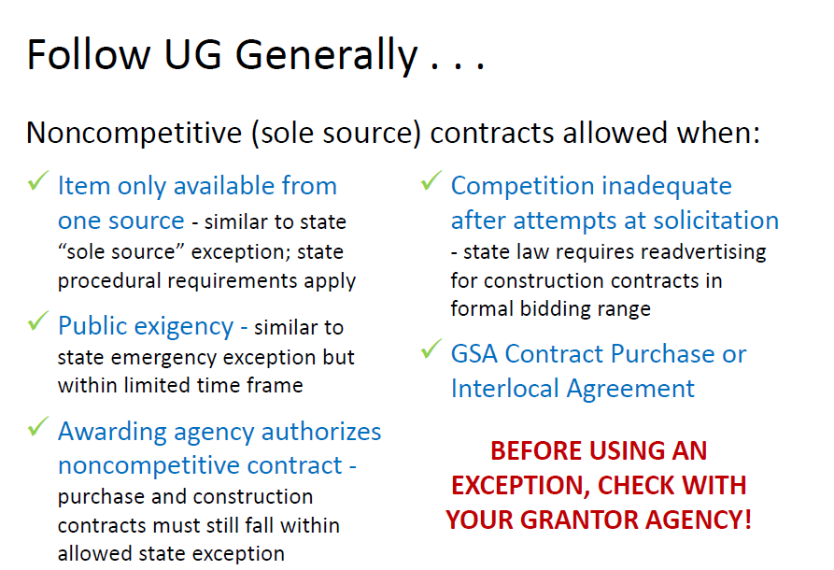

BIDDING EXCEPTIONS

Slide 29
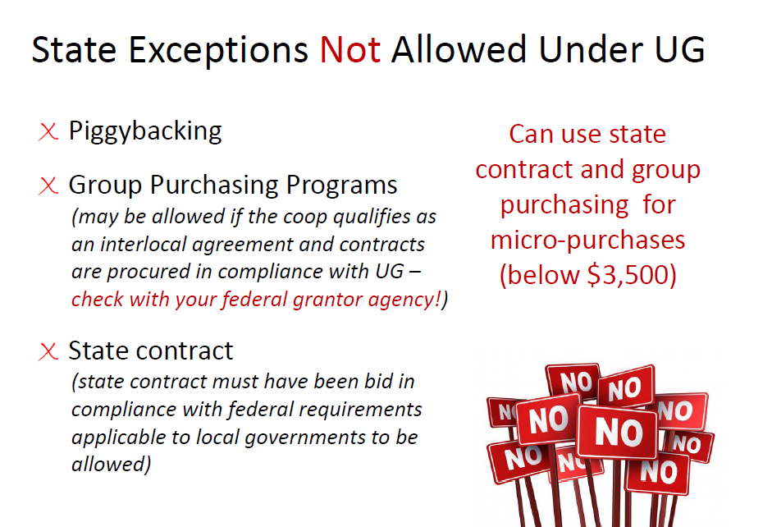


Below $10,000.00

Slide 30


WRITTEN POLICIES AND DOCUMENTATION
THE PURCHASING POLICY HAS BEEN UPDATED TO COMPLY WITH ALL UG
REQUIREMENTS AS OF JUNE 19, 2018
THE PURCHASE ORDER DOCUMENT HAS BEEN REVISED TO INCLUDE THE
FOLLOWING STATEMENT:
“Contracts funded with federal grant funds must be procured in a manner that conforms with all applicable Federal Laws, Policies, and Standards.
A CONFLICT OF INTEREST POLICY HAS BEEN ADOPTED BY THE WAYNE COUNTY BOARD OF COMMISISONERS ON JUNE 19, 2018
THE MEMORANDUM OF AWARD HAS BEEN REVISED TO ASSIST IN COMPLIANCE WITH THE UG REQUIREMENTS
A CHECK LIST HAS BEEN CREATED TO ASSIST DEPARTMENTS IN FOLLOWING THE UG REQUIREMENTS.

Slide 31




PUT ALL CONTRACTS IN WRITING!

Slide 32

Just in case you are completely overwhelmed…..

Slide 33
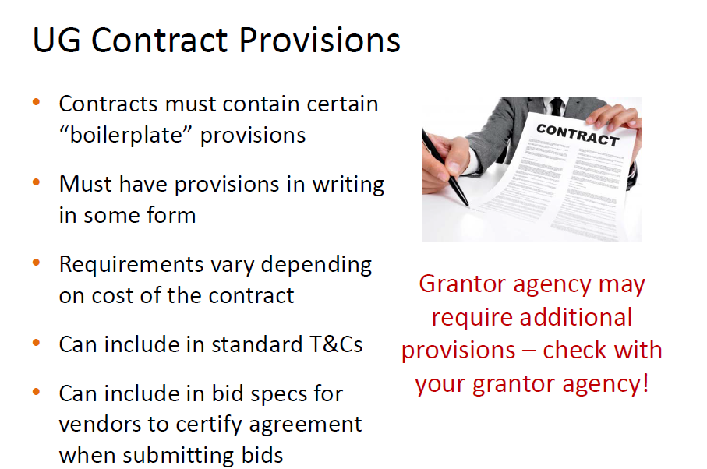


Slide 34
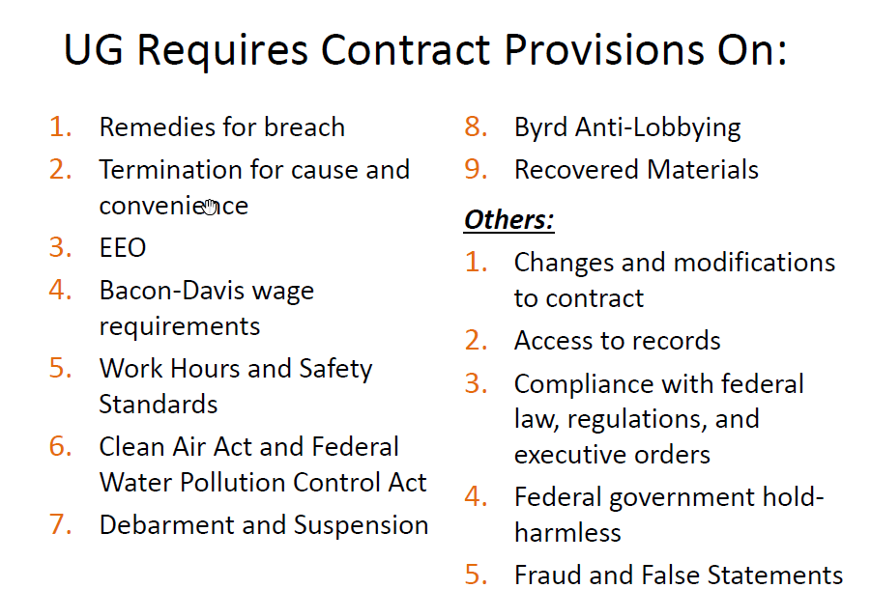

Give your Attorney something to do!

Slide 35
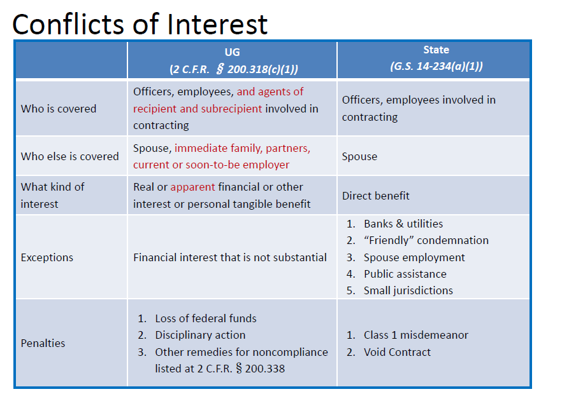


Slide 36

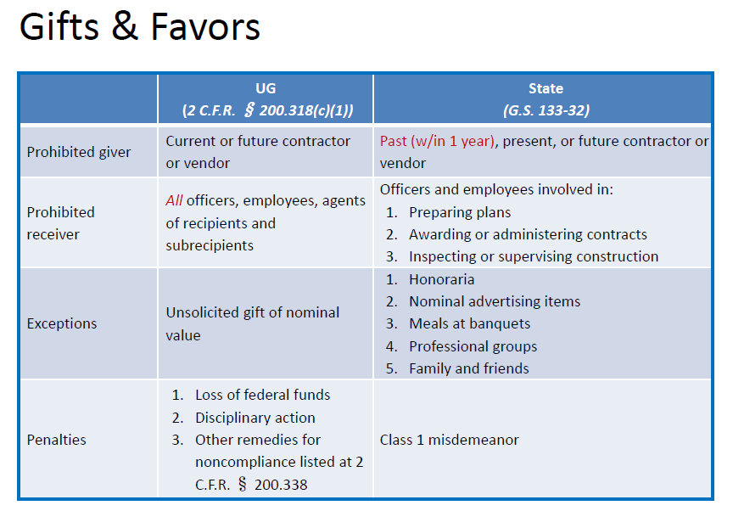

Slide 37
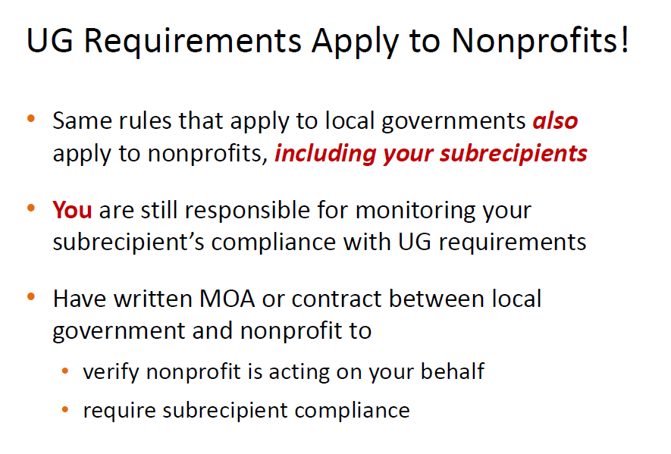


Slide 38

WHAT DO I DO NOW?
PROVIDE ALL GRANT APPLICATIONS AND GRANT AWARDS TO PHIL PARRY IN THE FINANCE OFFICE.
ALWAYS ASK WHERE ARE THE FUNDS COMING FROM TO PAY FOR THIS PURCHASE. IF YOU ARE UNSURE YOU NEED TO FIND OUT.
IF THE ANSWER IS FEDERAL FUNDS, PULL OUT THE CHECKLIST THAT HAS BEEN PROVIDED
QUESTIONS????
CALL PHIL PARRY AT 1469 FOR ANY GRANT RELATED QUESTIONS.
CALL NOELLE WOODS AT 1714 FOR PURCHASING RELATED QUESTIONS.

Slide 39
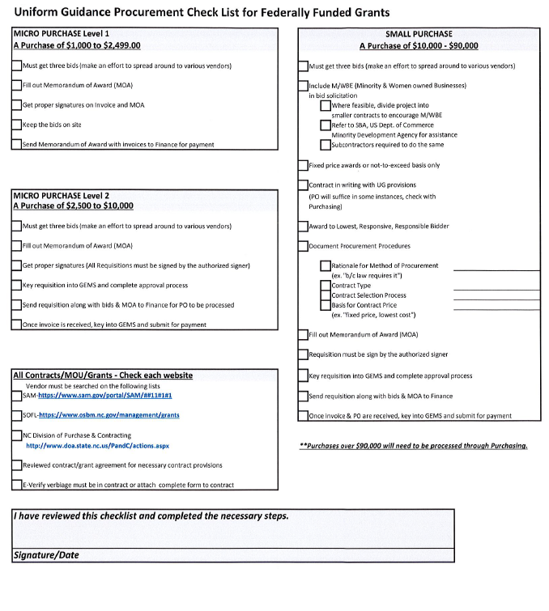
UG
CHECKLIST

Slide 40
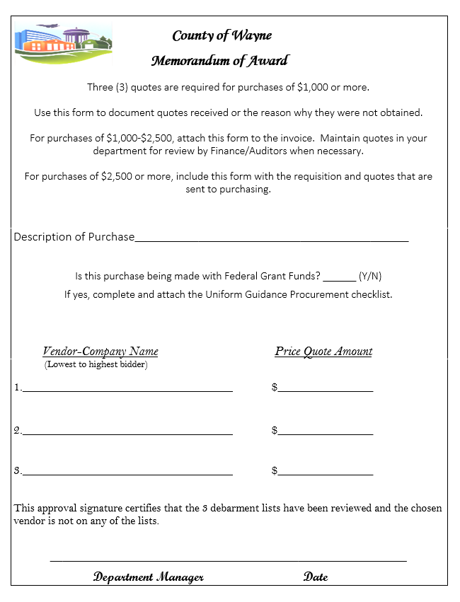
Memorandum
of
Award

Slide 41







